Slide 1
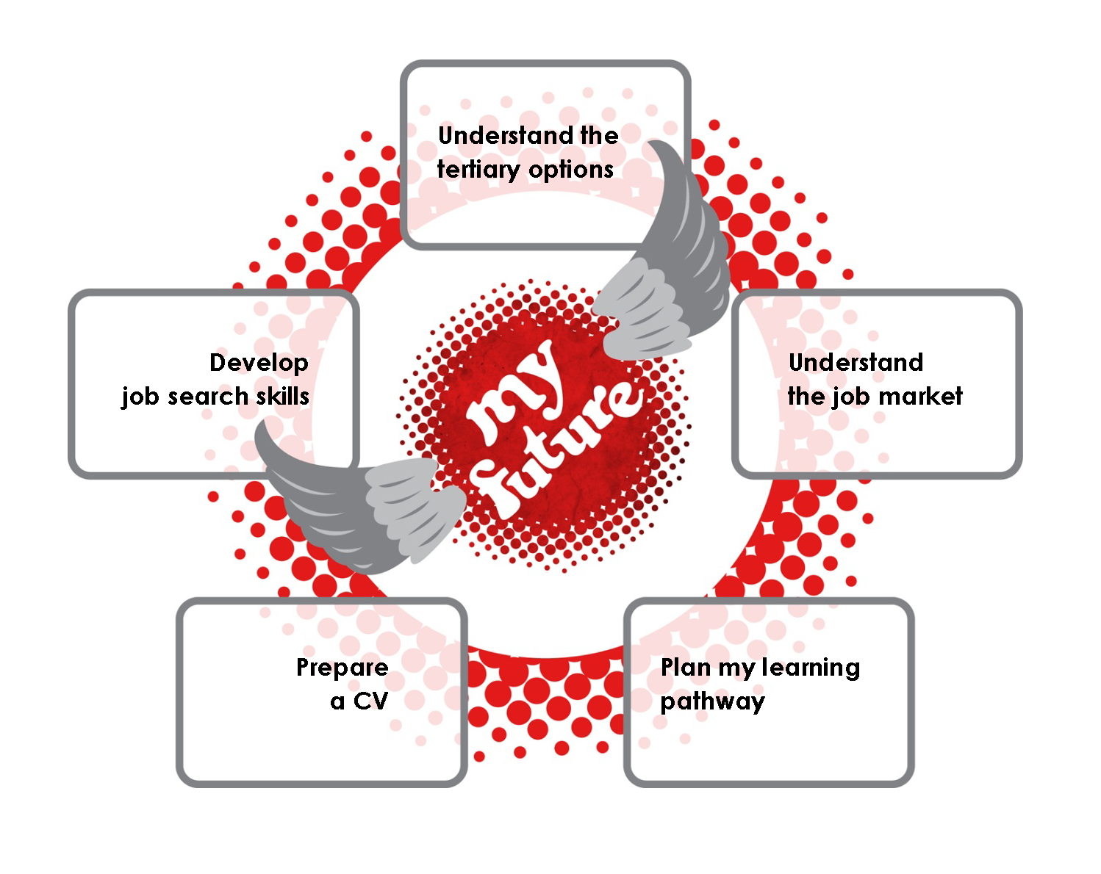

Decide and Prepare

Slide 2
Understanding tertiary options
Section 1

Slide 3
What kinds of qualifications are there?
Understanding tertiary options

Slide 4
qualification types
Levels 7-10
degrees, graduate and postgraduate qualifications
Levels 4-6
advanced trades, technical and business qualifications
Levels 1-3
senior secondary education (eg, NCEA) and basic trades training
Notes:
Animated slide. Click to make each to the two higher levels appear.
This diagram gives a general picture of what kinds of qualifications exist.
It shows the levels, but the levels themselves are not the important thing. Many students will never need to know the actual level of the course they are studying. (See below for explanation of levels if needed.)
It is good for students to understand that a lot of qualifications can be a stepping stone to one at a higher level
It is useful to point out that school qualifications fit into this structure.
There are ten levels of qualifications in New Zealand. Each level is based on the complexity of learning, with level one the least complex and level ten the most.

Slide 5
qualification names
bachelors,
honours, masters,
doctorates, PhDs
graduate and postgraduate certificates and diplomas
certificates,
diplomas,
national certificates, national diplomas
Notes:
Animated slide. Click to make blocks of names appear.
There are the most common names for qualifications in New Zealand. Their position on the slide indicates their approximate levels.
Students are likely to have heard of some of these. They may not understand the following distinctions:
National certificates and diplomas:
Graduate and postgraduate courses:
The student worksheets have explanations of these terms.

Slide 6
typical completion times
for full-time study
certificates general, national, graduate, postgraduate | a few months, up to 1 year
diplomas general, national, graduate, postgraduate | 1 or 2 years, can be more
bachelors degrees, honours degrees | 3 or 4 years, can be 5
masters degrees | 2 years
doctorates, PhDs | 3 years
Notes:
There are the most completion times for qualifications in New Zealand when studied full time, but there is variation.

Slide 7
the meaning of words
study
training
When people talk about study they are often talking about learning at an education provider,
eg, school or university.
But, some study courses include on-the-job training through work placements.
When people talk about training they are often talking about learning on the job.
But, many workplace training programmes include off-the-job study.
Notes:
Animated slide. Click to make ‘definitions’ appear. They appear together.
First check how students understand these terms. Some may think:
Study means university and training means polytech
Apprenticeships are the only form of learning on the job
Then show definitions
Introduce ideas about workplace training as needed.
Student worksheet has an explanation.
Emphasise that you need to find a job first before you can do workplace training.

Slide 8
Where can I get a qualification?
Understanding tertiary options

Slide 9
tertiary providers
3 wānanga
8 universities
20 polytechnics and institutes of technology (ITPs)
38 industry training organisations (ITOs)
+ hundreds of private training establishments(PTEs)
Notes:
There is quite a lot of choice in types of learning available after school. So have a quick discussion about what is the same and different about these options. This might cover key points listed in the student worksheet, and included below, as well as things like:
Locations and what is available locally
Sizes, typical learning environment and teaching approach
Ownership
wanānga
learning in keeping with ahuatanga Māori and tikanga Māori (Māori tradition and custom).
universities
academic focus―content is largely theoretical, but some courses have a practical element, eg, engineering, dentistry, PE
polytechnics and institutes of technology
stronger vocational focus―skills and knowledge you need for a job. Many courses connect students with workplaces.
Industry training organisations (ITOs)
training programmes in the workplace. You have to have a job first. You work towards a qualification at the same time as you work. This may require completing some off-the-job courses
Private training establishments (PTEs)
Often focus on a few specialist fields, such as hospitality, business, driving, drama or hairdressing.

Slide 10
Can I do any course I want?
Understanding tertiary options

Slide 11
entry requirements vary
… from course to course and place to place.
  You might need a set number of credits in particular school subjects.
  When there are a limited number of places in a course, meeting the minimum entry requirements might not be enough.
  Course providers may want to see portfolios, experience in the workplace, evidence of commitment or certain personal qualities.

Slide 12
entry to university
Example: BA in history at Victoria University
  Minimum requirement is University Entrance
  For guaranteed entry you need a score of
  150 points based on up to 80 of your best credits
  For example, 10 credits at excellence (40pts),
  10 credits at merit (30pts) and 40 credits at achieved (80 pts).
    excellence=4 pts, merit=3 pts, achieved=2 pts
Notes:
Replace with example that fit your students and location.

Slide 13
entry to polytech/institute
Examples from Weltec:
Diploma in Health Psychology Level 5
  NCEA level 2 with 36 credits in three subjects.
National Diploma in Architectural Technology Level 6
  50 credits at NCEA Level 2, with at least 12 credits in each
  of Maths, Science and English. Alternatively, applicants 20 years of age or older are welcome to apply.
  Successful completion of selected unit standards is necessary to gain entry into the second year of this programme.
Notes:
Replace with examples that fit your students and location.

Slide 14
entry to workplace training
Example: Retail modern apprenticeship
  You need to find a job in the industry and a boss willing to train you first.
  Requires you to successfully complete 147 credits at Levels 2 and 3 while you are working, so it helps to have NCEA Level 1 plus literacy and numeracy.

Slide 15
flexible options
There are options that allow you to continue to explore what suits you as you go.
  These may be a good idea if you know the broad area you are interested in but aren’t
  sure what sort of job you’re heading for.
  Examples are:
  a general degree, eg, Bachelor of Arts or Science
  Pre-trade training, eg, plumbing

Slide 16
what you can do now
Think about …
Start thinking about the way you might want to learn once you finish school. The tertiary study and training options available offer you different ways of learning.
Think ahead …
When you choose your senior school subjects, check out whether your subjects will allow you to get into the tertiary study and training pathways you might want to follow.
Notes:
Animated slide. Click to make Think ahead paragraph appear.

Slide 17
Finding your networks
Section 2

Slide 18
Your network is …
The people who know you well
church group . ministers . boss teachers . coach . team mates neighbours . hairdresser . vet
barista . gas station guy
doctor . chemist
The people who sort of know you
The people
you can start a conversation with
parents . sisters
brothers . close friends classmates . aunts . uncles
cousins . grandparents
co-workers . fellow students
club or group members
Often it is these people who give you the best new leads
Notes:
Animated slide. Click to make objects appear.
Introduction before you build the complete slide.
Your “network” is your personal connections, the people you see and interact with in all the activities you do (and have done) at school, at home, at work and in your community. We all know people, and we all have networks.
This may be an good time to discuss where friends and followers on online social networking sites fit in this picture.
Follow slide by asking everyone to write down the people they could include in their network under the groupings used above.
Remember, when you are identifying your networks think of everyone you possibly can. Your view should be as wide as possible.

Slide 19
Networking is …
person
3
you
goal
person
1
person
2
X
X
Notes:
If students have been involved in The Real Game activities you could remind them about the High 5 principle of ‘accessing your allies’
Networking means using your contacts to find information or opportunities.
It begins with people you know.
They may be not be able to help you directly but they may be able to put you in touch with people they know, and so on.
Have you used your network to get something you wanted? Think about school projects, hobbies, even favours.
Why do it?
The more ways you look for information or opportunities the more likely you are to find them.
Research in the US and UK suggests that about 60% of people get jobs in informal ways rather than through ads, agencies, etc.
Being introduced to people by people they know and trust can sometimes give you an advantage

Slide 20
Networking example
Jo wants to explore nursing as a career option
cousin
friend
(nursing home
manager)
doctor
Jo
family
friend
colleague
(nurse)
minister
colleague
(nursing agency)
aunt
friend
(case manager)
church member
(social worker)
Notes:
Animated slide. Click to make objects appear.
Look at this example and discuss what help Jo might have got from each of the people she contacted through her network.
Here are four ways people may help. You may think of others.
lead you to other people, who can offer new leads and connections
give you a better idea about jobs or workplaces you are interested in
arrange opportunities to visit or experience a workplace
even lead you to actual job opportunities sometimes.
Remember
When you think about who in your network you might talk with, don’t just ask yourself “Who do I know who can hire me?” or “Who has a job I might be interested in doing right now?”. The people you know, know people, who know people …

Slide 21
Doing it right
Think about how you can make
a good first impression
appearance
friendliness
curiosity
honesty
MUST DO #1
Create a positive
impression of
yourself
Prepare yourself to emphasize
your positive qualities
People say
I’m …
I’ve had
good feedback about …
Notes:
Animated slide. Click to make side text appear.
Building network relationships is like building new friendships. First impressions count. But if people are going to want to help you find information or opportunities, and be able to do that, they also need then to see you as someone with talents and skills that will be of benefit to others.
So, even though many of us don’t feel 100% comfortable talking about our strengths, you do need to find ways to give people a sense of what you are good at and what you can offer to an employer, etc.
This could be another time to discuss social networking sites and how employers and others check them. So, will your public profile give others a positive impression of you?

Slide 22
Doing it right
You can tell people about what you are looking for without directly
asking for help.
This may
lead you to someone who could help you.
MUST DO # 2
Tell people about
your interests
and goals
Decide what is reasonable to ask of people.
How strong is
your connection?
How willing is
the person?
How much hassle is your request?
Notes:
Animated slide. Click to make side text appear.
Everyone in your network should know you are looking for information or opportunities.
When talking to contacts about what you are looking for ask them general questions like:
Do they know anyone who knows anything about the kinds of things you are interested in
Do they know anyone who studies/works in places that might have the types of courses/jobs you are interested in
Do they know anyone else you could talk to about your interests
When you find someone in an area you are interested in, start by asking them about what they do. Then ask about what you should think about or do if you were interested in doing the same or finding out more.

Slide 23

www.careers.govt.nz
Career Kete, Decide and Prepare section, April 2012
The information on networks in this presentation is based on ideas in Teaching Networking Skills: Paving a Way to Jobs and Careers, Aug 2008, Institute for Community Inclusion, UMass Boston. Downloaded December 2010 from http://www.communityinclusion.org/article.php?article_id=251

